Slide 1


BORCELLE
Home
Photo
About Us
Contact
GYM !!!
DEVELOPED BY ALI
01

Slide 2
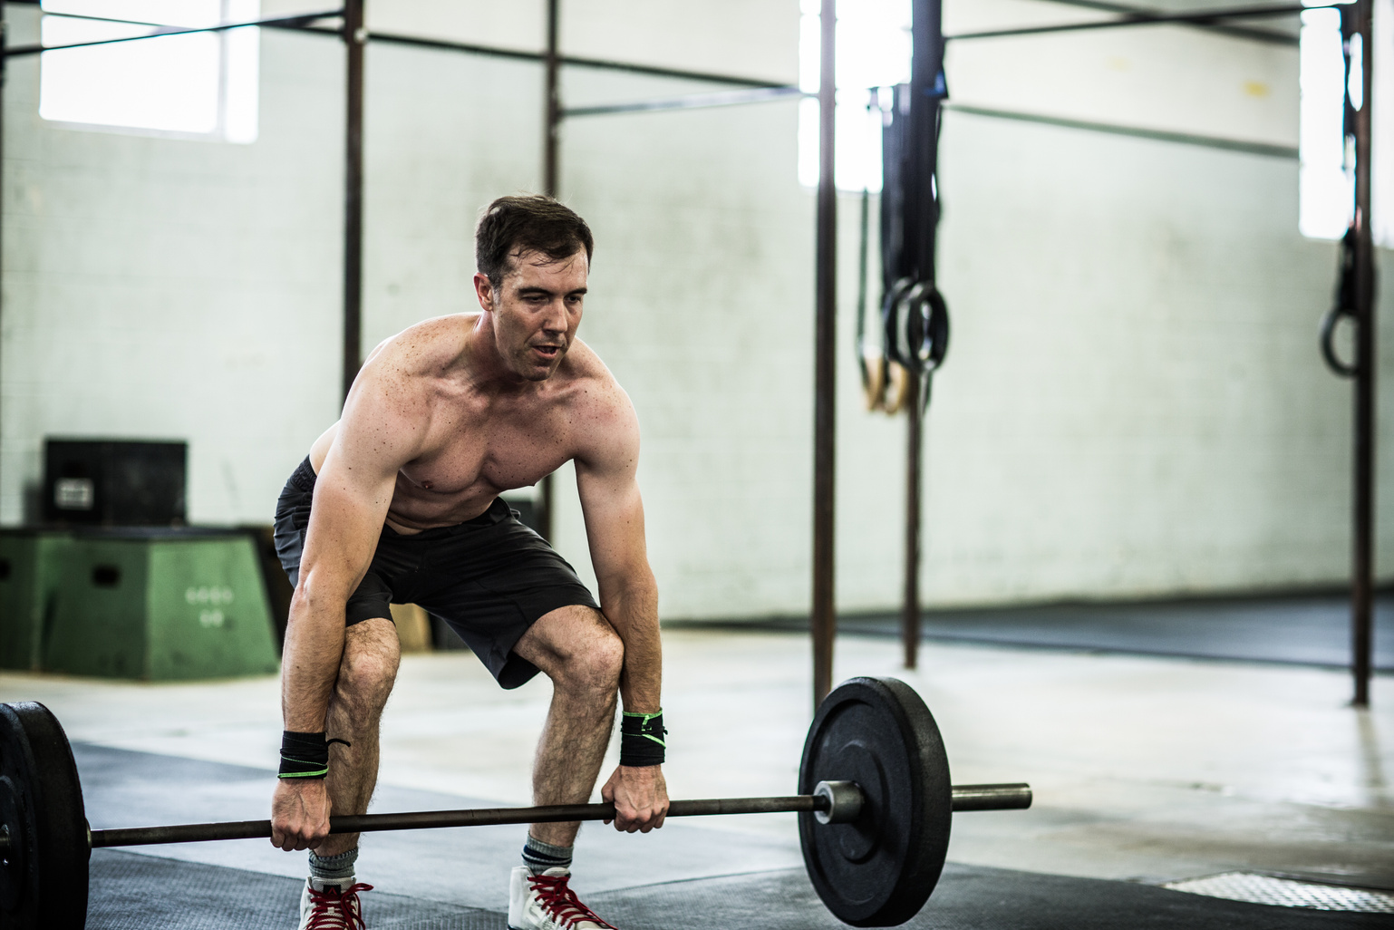
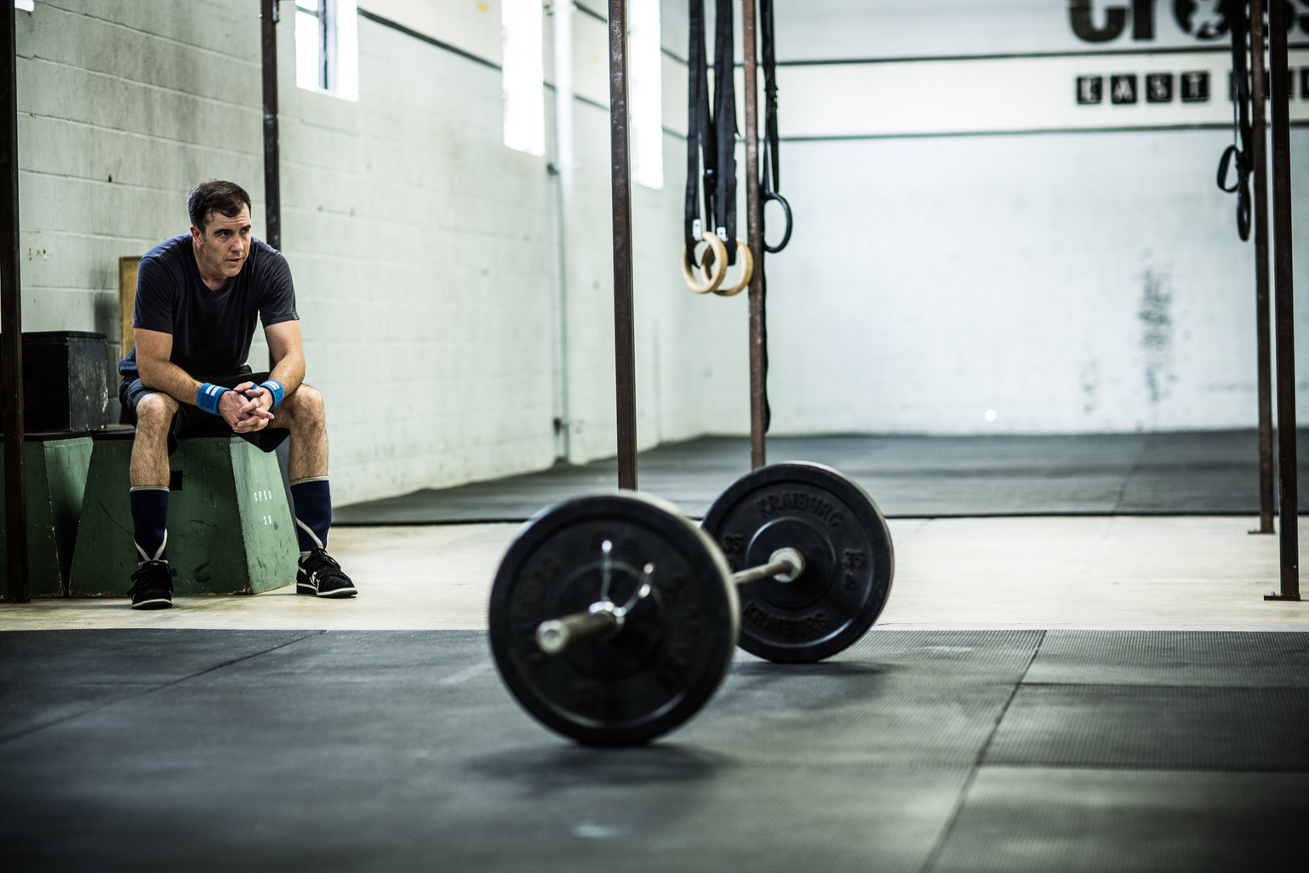
WELCOME TO OUR GYM
The Gym Backend is a robust and scalable API built with Go, designed to manage a gym's client and training data efficiently. It provides comprehensive CRUD (Create, Read, Update, Delete) operations for managing clients and training sessions, ensuring smooth and organized operations. This backend is tailored to handle authentication, user roles, and secure data management, making it an ideal solution for gym management systems.
During developing this project i have a lot of ideas, why i am doing this, and why i am not creating something more funny and scalable, but why not. I like training and this project is kinda cool i guess
01

Slide 3
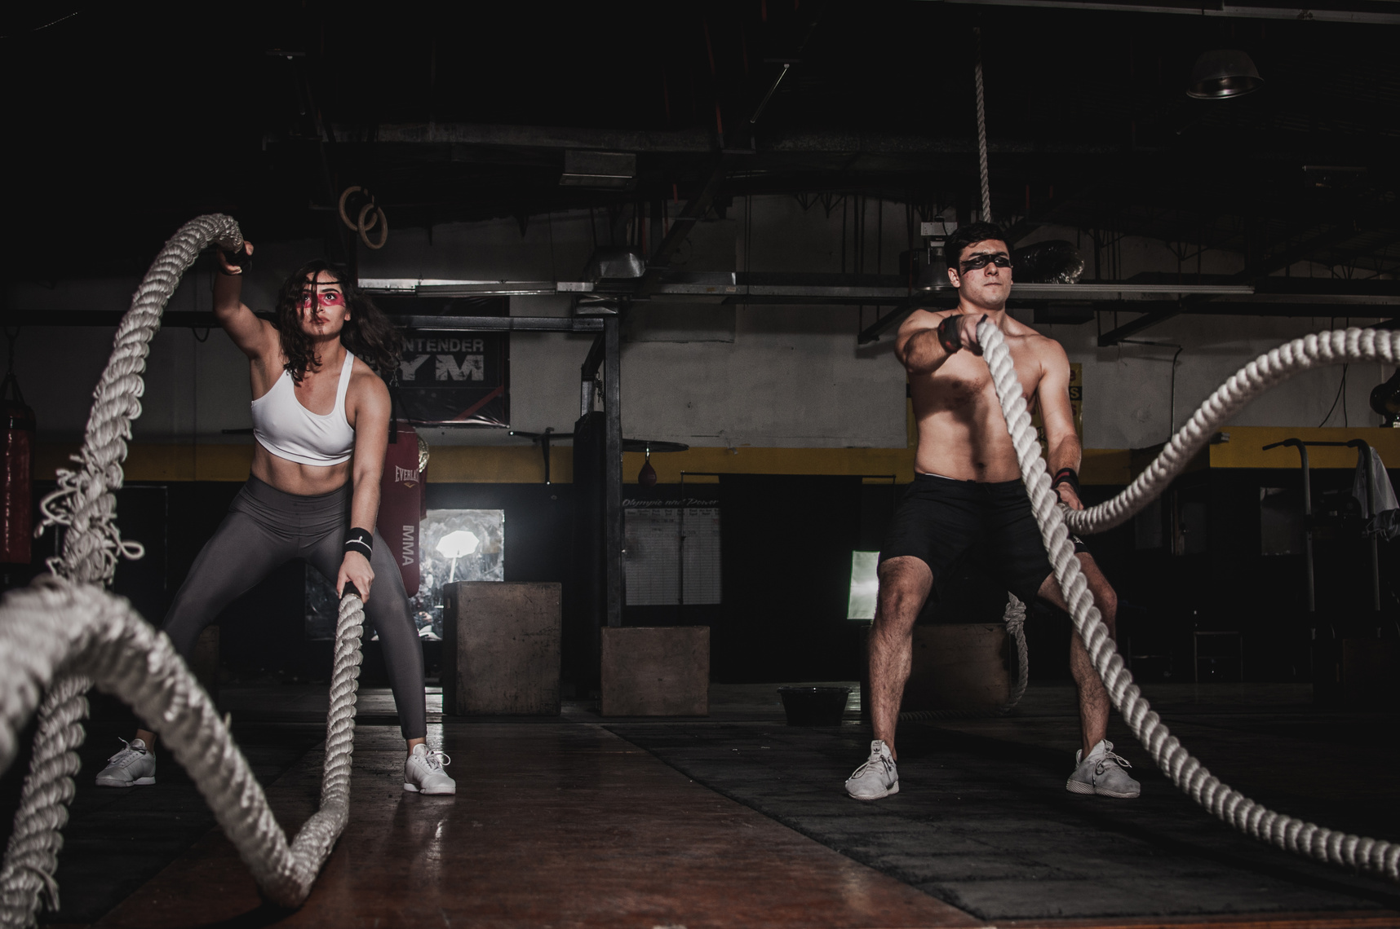

JOIN OUR GYM TODAY!
About Company
Are you ready to transform your life and achieve your fitness goals? Look no further! Our state-of-the-art gym is the perfect place to start your journey towards a healthier, stronger, and more confident you. Whether you’re a seasoned athlete or just beginning your fitness adventure, we have something for everyone. Without “I like swimming”
03

Slide 4
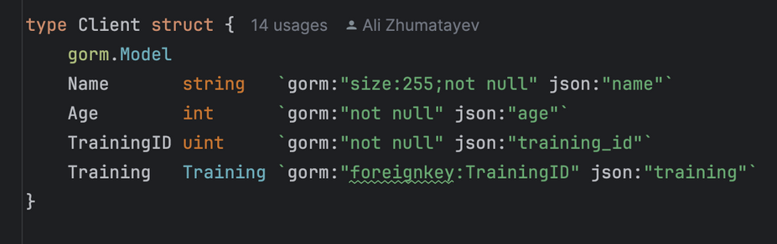
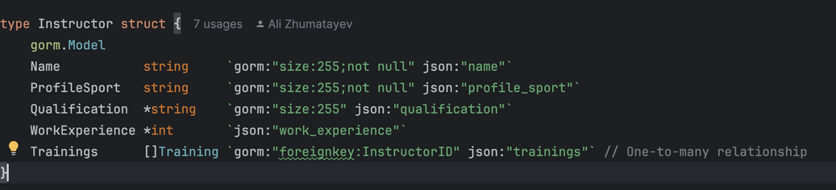
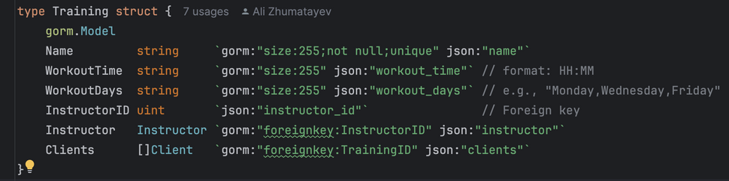
BORCELLE
Home
Photo
About Us
Contact
ENTITYS
CLIENT
INSTRUCTOR
TRAINING
04

Slide 5
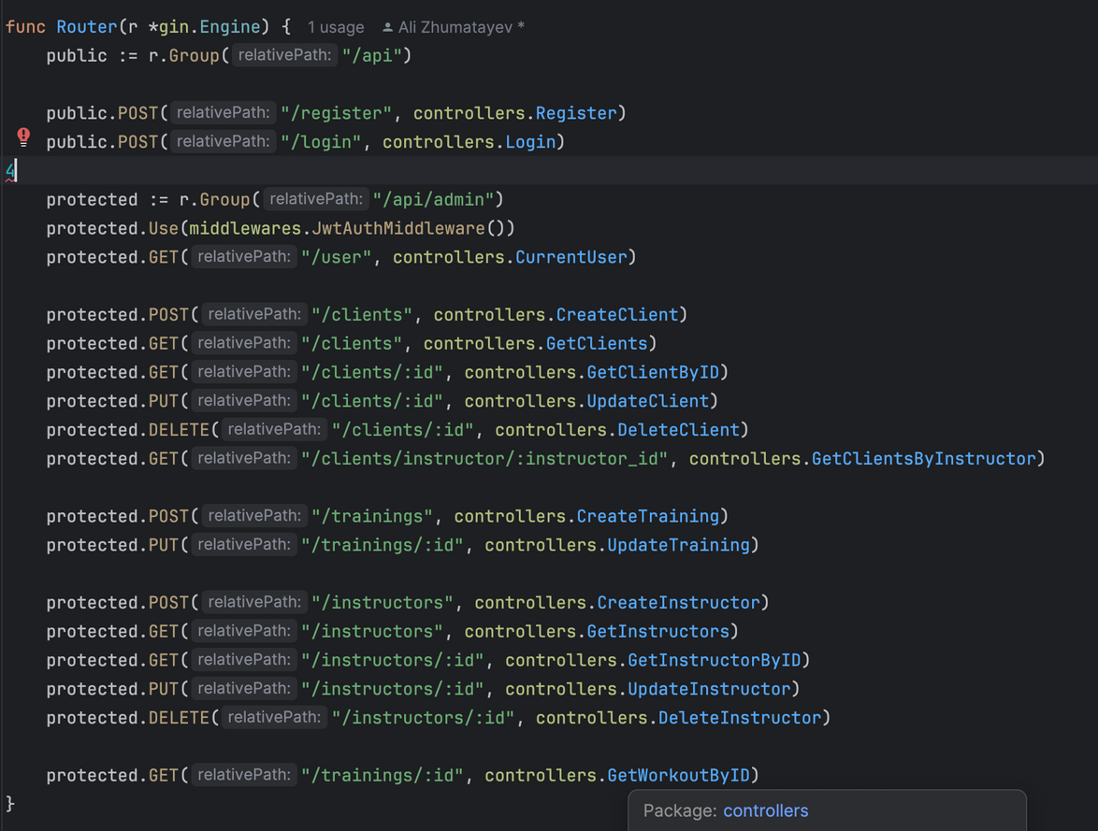
ROUTES
08

Slide 6

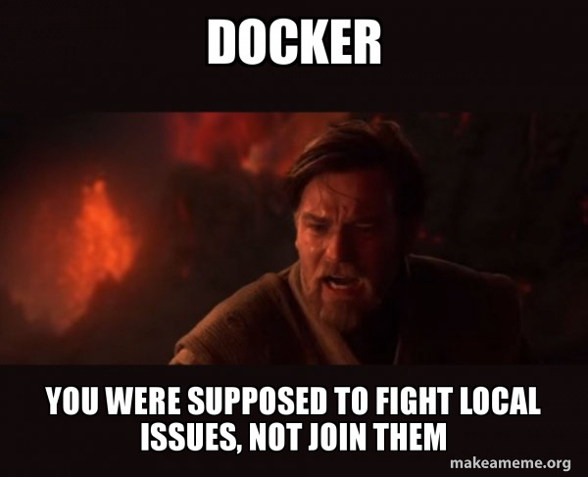
PROBLEMS I HAVE
01
Working with database, a lot of problems
02
Docker
05

Slide 7

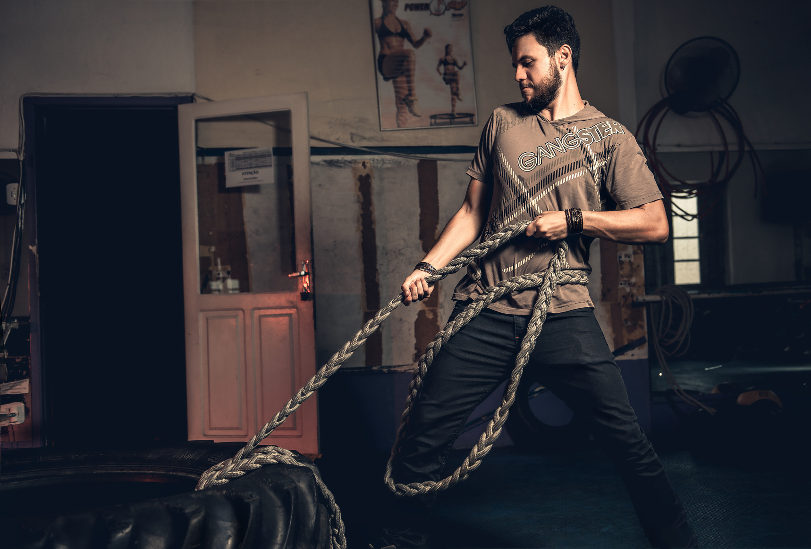
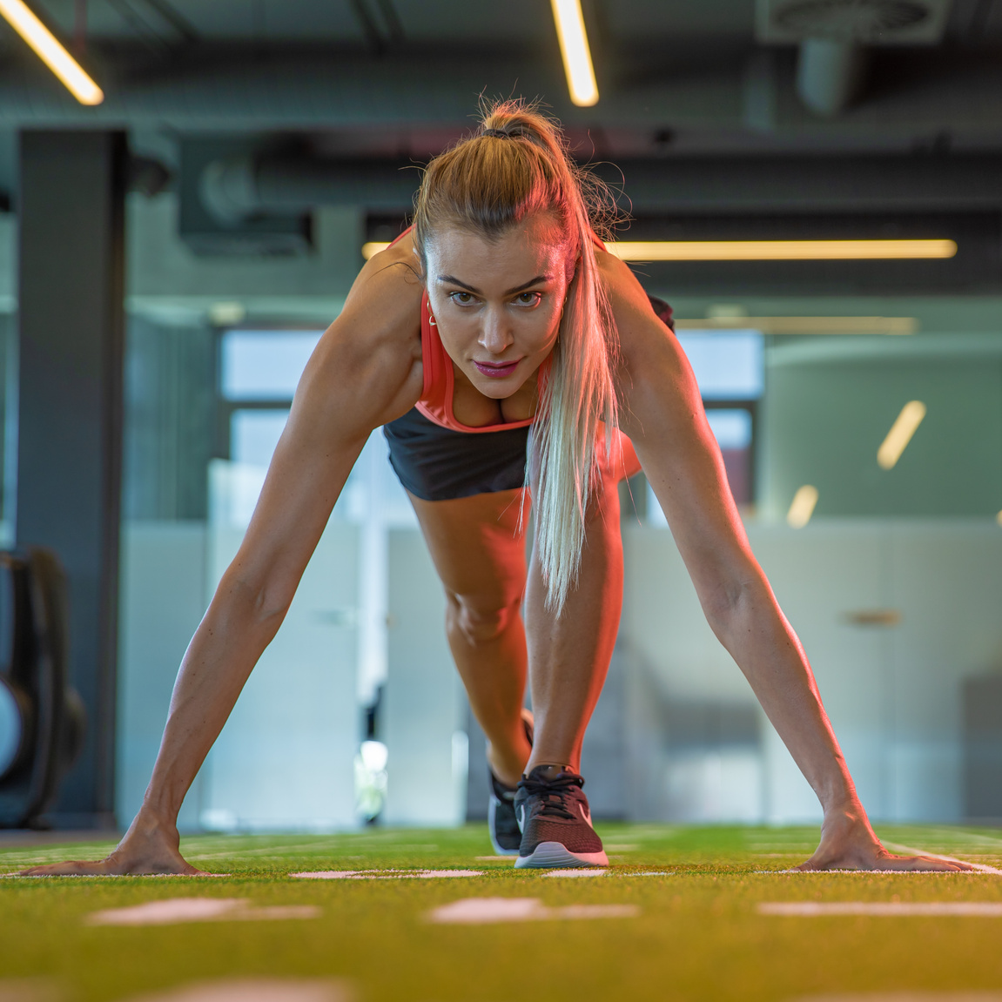

BORCELLE
Home
Photo
About Us
Contact
MEET OUR TRAINER
Brigitte Schwartz
Yura
Eva
Ali
Best crossfitte and mother of the 3 kids.
kms in Bodybuilding
Cycling trainer World Championship winner
Judo trainer and good backender (only he thinks like this)
07

Slide 8
BORCELLE
ME AND MY EMOTIONS DURING DEVELOPMENT
09

Slide 9

BORCELLE
at the beginning
09

Slide 10

BORCELLE
in the middle / or during setting the docker
09

Slide 11

BORCELLE
at the end (i dont need docker and deployment)
09

Slide 12

THANK YOU
it was great semester and good practice in developing RESTapi and petProject
10

